Slide 1
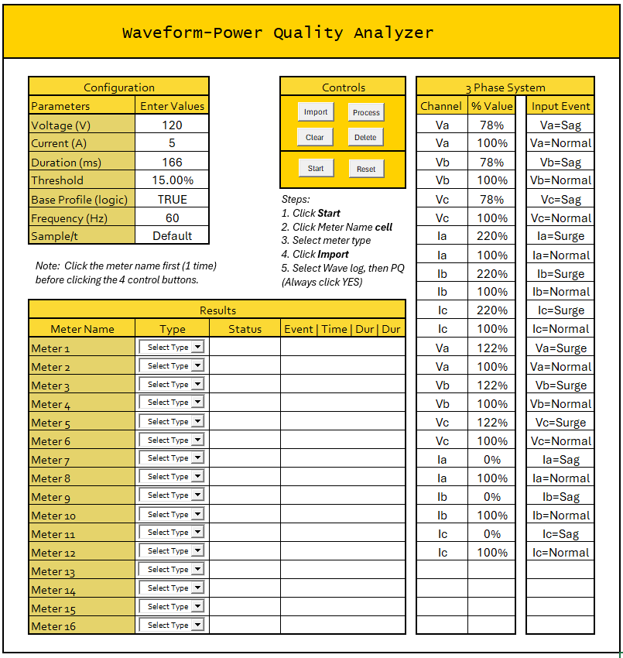
To discuss:
Wave capturing process
Logic
Parts and Limitations
Flow

Slide 2
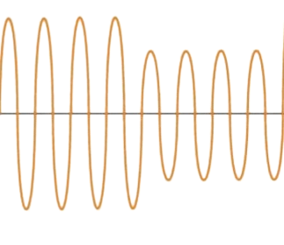
Wave Capturing Process
Original Waveform (with sagging)
Waveform Capture
PQ Capture
Trigger Time
Trigger Time
What can waveform capture can look like:
What can PQ Capture can look like:

Slide 3
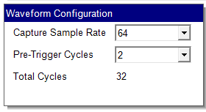


Wave Capturing Process
Waveform Capture
PQ Capture
Not to scale
Capture Duration (s)
Total Event duration (s)
Duration (W) = Total Cycles * Period
Duration (PQ) = Duration of Input
Duration (W) = Total Cycles * $\frac{1}{Frequency}$
Duration (W) = 32 Cycles * $\frac{1s }{60 Cycles}$
Duration (W) = 533 ms

Slide 4

Logic
Waveform Capture
PQ Capture
Trigger Time
For both logs to be Valid, the following must be satisfied:
Start Time = Trigger Time
Trigger Time (W) = Start Time (PQ)
Trigger Value = Threshold ± Boundary
(Threshold can be a user defined value or based on specifications)
Duration (W) = Total Cycles * $\frac{1}{Frequency}$
(Default Total Cycles value varies depending on the meter)
Wave Duration (PQ) = Set duration of event in power source
# Wave Logs = # Sag/Surge Events set in the source

Slide 5
Parts & Limitations:

Slide 6
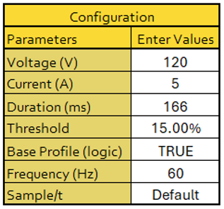
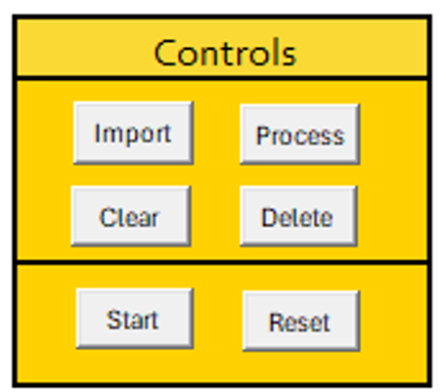
Parts & Limitations:
Assuming all meters have the same class.
Assuming all events have the same duration
Display only for now

Slide 7
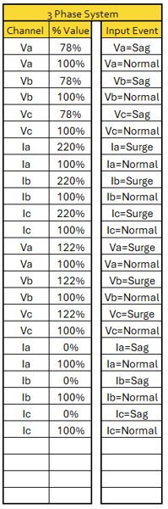
Parts & Limitations:
This only reflects the Sequence of events programmed in the Omicron’s State Sequencer Tool
Manually input only.
Only Channel and % Value Column are editable.
The checker can only process sequence of events like this. One events at a time.
Editable Cells

Slide 8
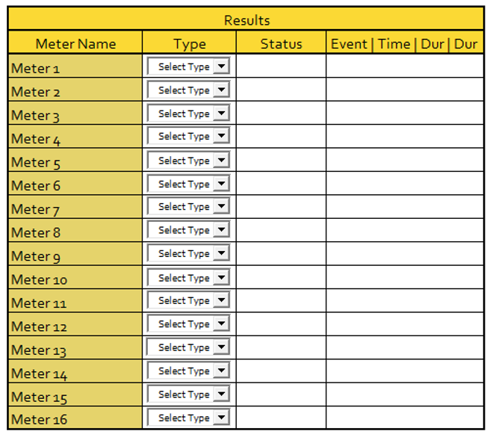
Parts & Limitations:
Satisfactory or With Issue
Editable Cells
Will only be filled if there is an issue. There is a count for each.

Slide 9
Flow:
Configuration Tab must be filled with info.
3 Phase System Tab should be filled with the script.
The user will select a meter type and will import logs.
The user must import Waveform logs first before the PQ logs. (another step are still unhandled)
The logs will then be pasted and will be organized in a newly created sheet named after the meter name.
Lastly, the user will click process to analyze the data and will be able to see the evaluation table and red markings if there is an issue.

Slide 10
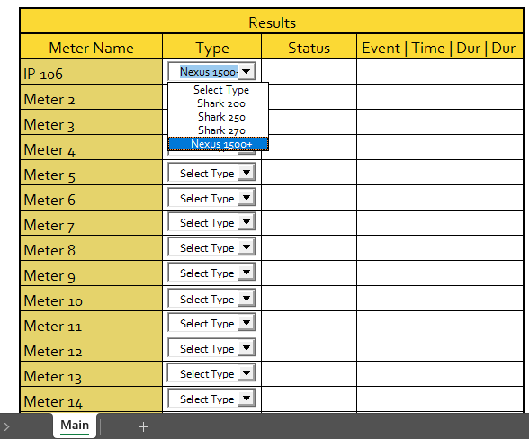
Flow:
The user will select a meter type and will import logs.

Slide 11
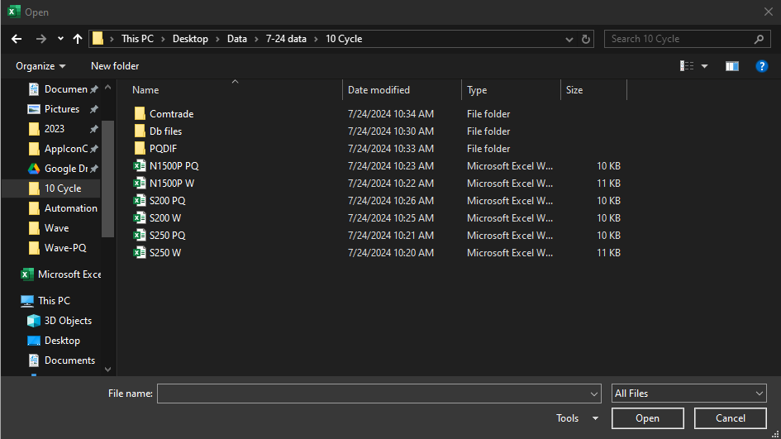
Flow:
The user must import Waveform logs first before the PQ logs. (another step are still unhandled)

Slide 12
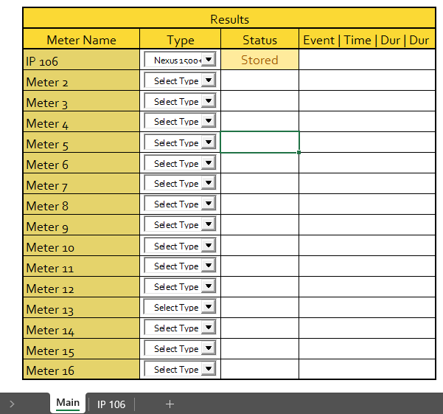
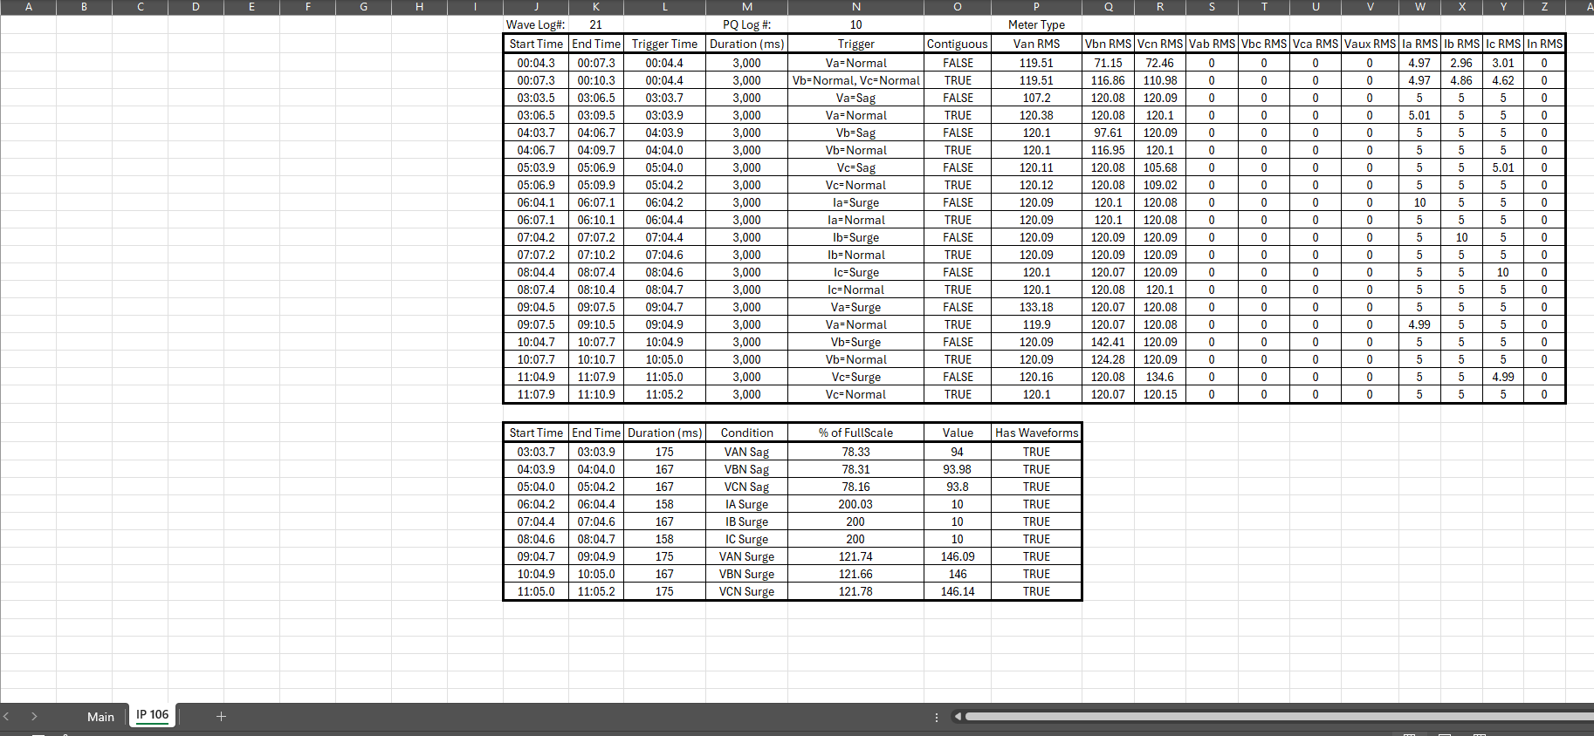
Flow:
The logs will then be pasted and will be organized in a newly created sheet named after the meter name.

Slide 13
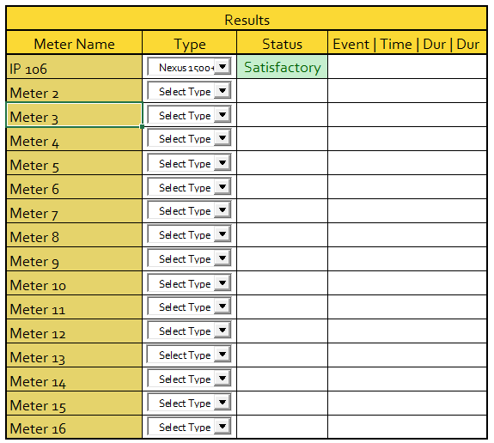
Flow:
Lastly, the user will click process to analyze the data and will be able to see the evaluation table and red markings if there is an issue.

Slide 14
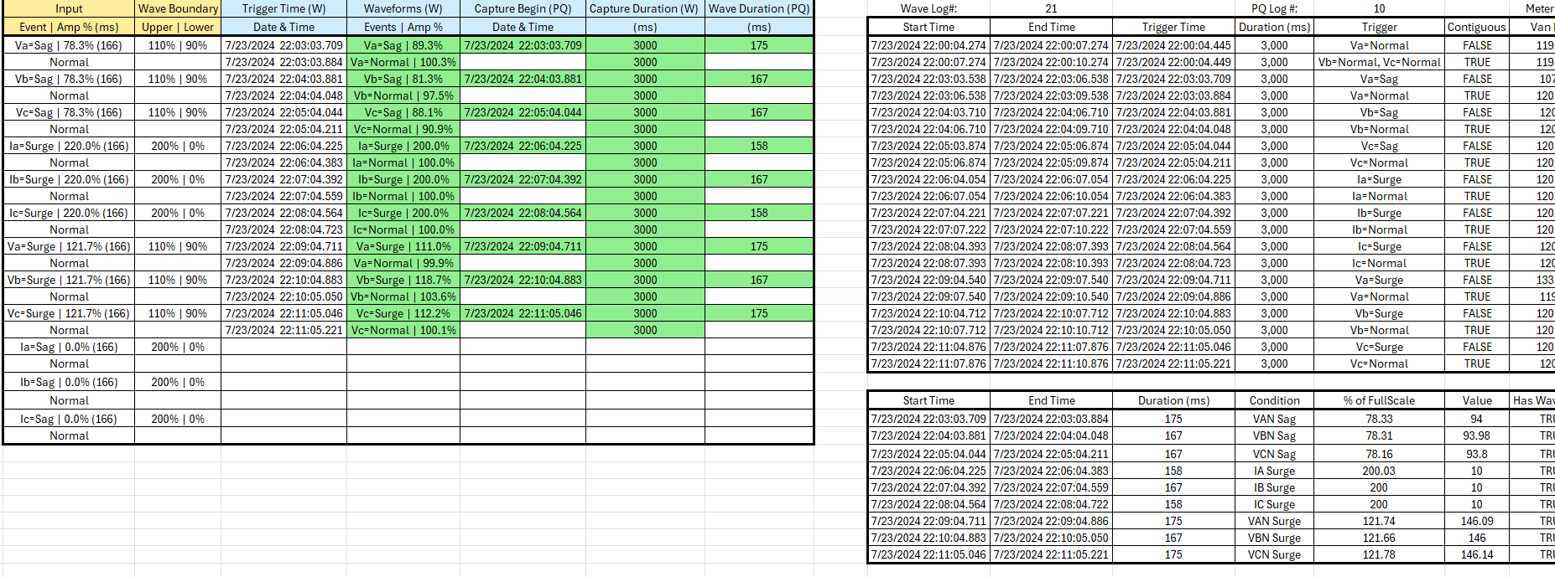
Flow:
Lastly, the user will click process to analyze the data and will be able to see the evaluation table and red markings if there is an issue.

